Slide 1
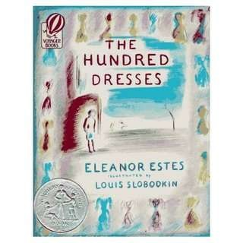
The Hundred Dresses - II

Slide 2

The Hundred Dresses - II
Before We Proceed:
1) How we judge the people around money, wealth and possessions? Or
us – by their
Is there something of more enduring value to look for in a person?
The largest wave of polish immigration occurred during the world war II. When more than one million poles are migrated to the United States.
Polish-Americans were sometimes discriminated against in the United States, as were Irish, Italians, and Jews

Slide 3

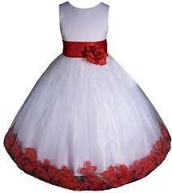
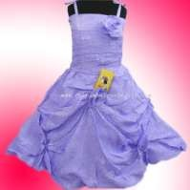
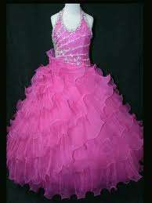

The Hundred Dresses - II
By: Eleanor Estes

Slide 4
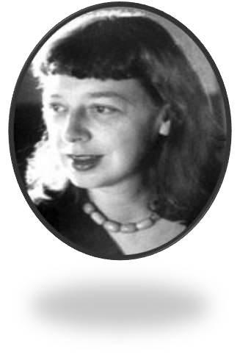
About the Author : Eleanor Estes
Eleanor Estes was an award-winning children's author. She first began writing during her recovery from tuberculosis, when, bedridden, she wrote down her own childhood memories as a series of stories for young readers.
In 1931 she was awarded the Caroline M. Hewins scholarship for children's librarians, and used these funds to attend the Pratt Institute.
Before her death in 1988 at the age of 82, Mrs. Estes had written 19 books for children, as well as one novel for adults.

Slide 5
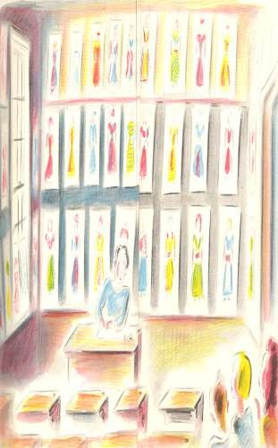
Key Points
The teacher makes the classroom fully attentive before reading out the letter written by Wanda’s father informing them about absence of Wanda and Jack from their school for good.
The Petronski family decides to settle in a big city so that their children don’t suffer from funny pranks played by their classmates.
The whole class along with the teacher got shocked with the content of the letter sent by Mr. Petronski.

Slide 6
Key Points
The entire class got tensed and they felt bad about Wanda. Maddie could concentrate on her studies.
She felt that she is coward and never stopped Peggy from
making fun of Wanda.
She wanted to meet Wanda. She made up her mind to go to her house and tell her that she has won the prize.
When the school was over Peggy and
Maddie went to Boggins Heights.

Slide 7
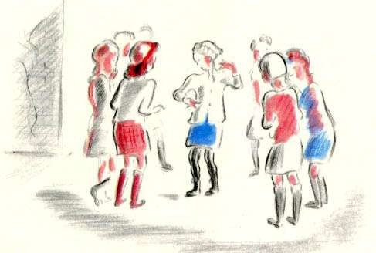
Key Points
Both the girls found her house but they could not meet her as they had already left the place.
Peggie tried to defend her behavior but Maddie is not satisfied.
On Saturday both Peggie and Maddie wrote a letter to Wanda telling her she had won the contest.

Slide 8
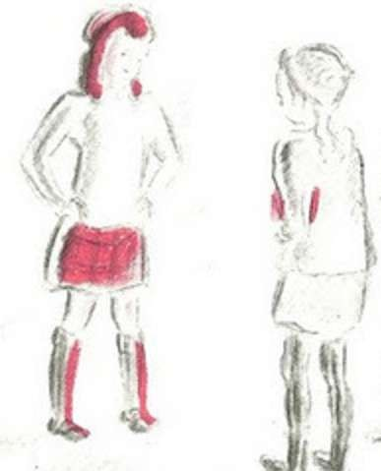
Key Points
Days passed but there was no answer from wanda.
It was Christmas time when Miss Mason received a letter from Wanda. Wanda had written a letter that the girls could keep those hundred dresses because in her new house she had hundred new ones.
She had gifted special drawing to Peggy and Maddie.
Maddie found that the face in the drawing looked like her.
She went to Peggy’s house and saw her drawing too.
She made up her mind to go to her house and tell her that found that the face and head of the drawing looked like their face and head.
Peggy consoled herself by saying that Wanda really liked them Maddie agreed and blinked away the tears that came every time she thought of Wanda Petronski.

Slide 9
Key Points
Both the girls found her house but they could not meet her as they had already left the place.
Peggie tried to defend her behavior but Maddie is not satisfied.
On Saturday both Peggie and Maddie wrote a letter to Wanda telling her she had won the contest.

Slide 10





The Hundred Dresses - II

